Slide 1
CSE470: Software Engineering
Agile Methodologies

Slide 2
Why we need Agile
1. Now a days, the requirement of software changes frequently, even it can change a number of times in a day.
2. Agile software engineering represents a reasonable alternative to conventional software engineering. It has been demonstrated to deliver successful systems quickly.
3. For live systems, like Amazon, Facebook a few seconds of downtime can cause a lot. Changes in such cases needs to be smooth enough so that customers interaction do not interrupt.
Read to know more about Agile benefits: click here

Slide 3
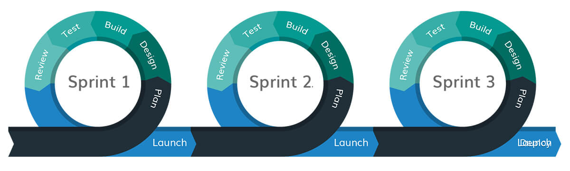
What is “Agility”
Agile is a set of principles and values. It is a practice to be followed.
Agile is a combination of Iterative and Incremental process models with focus on process adaptability and customer satisfaction by rapid delivery of working software.
Agile organizations tend to be responsive rather than rigid, which means they can better respond to change.

Slide 4
Agile Manifesto
We are uncovering better ways of developing software by doing it and helping others do it.
✔ ❌
Individuals and interactions over processes and tools
Working software over comprehensive documentation
Customer collaboration over contract negotiation
Responding to change over following a plan
Read more: https://agilemanifesto.org/
At a glance: https://agilealliance.org/

Slide 5
Agile Methodologies
Extreme Programming
Agile Unified Process (excluded from syllabus)
Scrum

Slide 6
Extreme Programming
In short also known as XP
XP is especially valuable for projects with unclear or dynamic needs
New versions may be built several times per day
Increments are delivered to customers every 2 weeks (approx.)
All tests must be run for every build and the build should be accepted by the client and if tests run successfully.

Slide 7
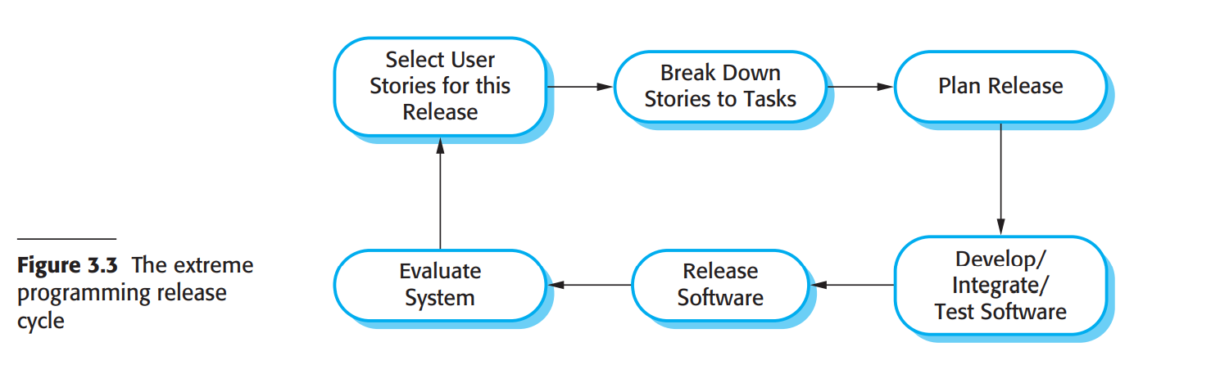
XP Workflow
Reference: Software-Engineering-9th-Edition-by-Ian-Sommerville (pdf page 82)

Slide 8
XP Principles or Practices
Incremental Planning | Pair Programming
Small Releases | Collective Ownership
Simple Design | Continuous Integration
Test First Development | Sustainable Development
Refactoring | On-site Customer

Slide 9
Pair Programming
Two people code in share, they switch roles from observer to navigator frequently
Observing code produces better code, so less business cost.
Support each other, better chance for learning.

Slide 10
Test First Development
Writes unit test for each method to identify problems and resolve it
Test First Development (TFD) is used to ensure better code quality and less error. It refers to write test code first and after that write the development code.

Slide 11
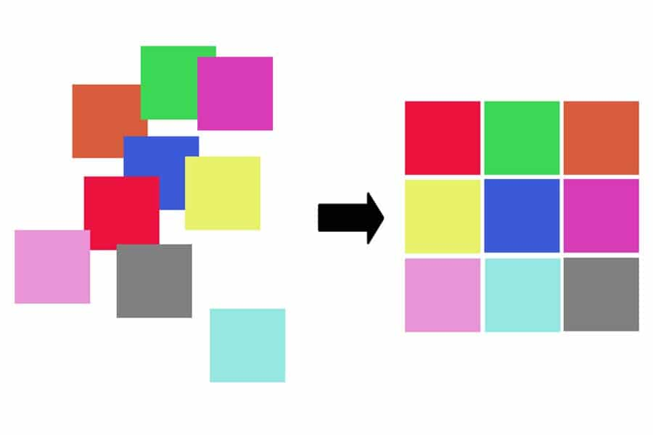
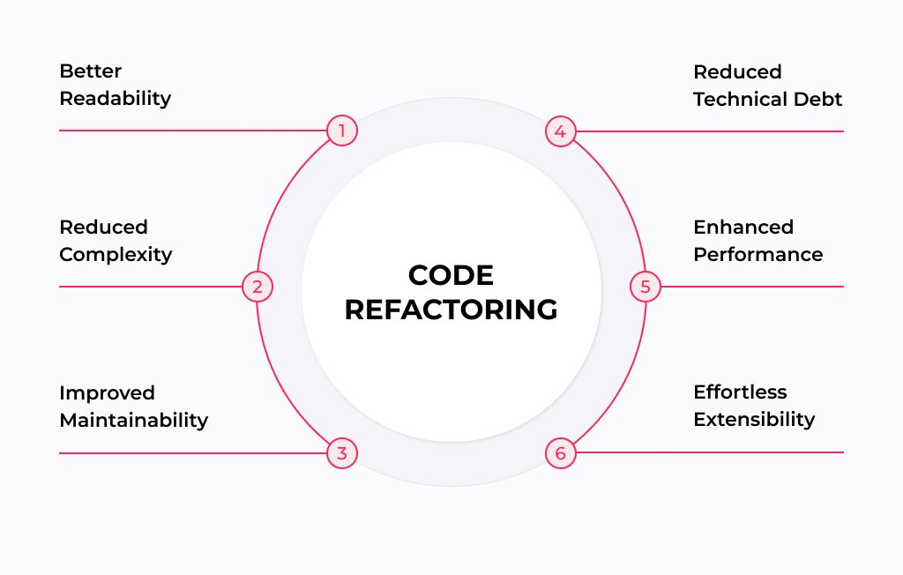
Refactoring
It’s a technique for restructuring existing code by changing its internal structure without changing its external behaviour.
Refactoring includes reducing duplicate codes, breaking long classes/methods into small ones, appropriate variable naming and many more.
It is done for requirement change, improving design and easy extensibility of software.

Slide 12
Scrum (Most popular Agile method)
It is the most widely used Agile S/W development method for project management
The full software is delivered in 1-4 weeks iterations

Slide 13
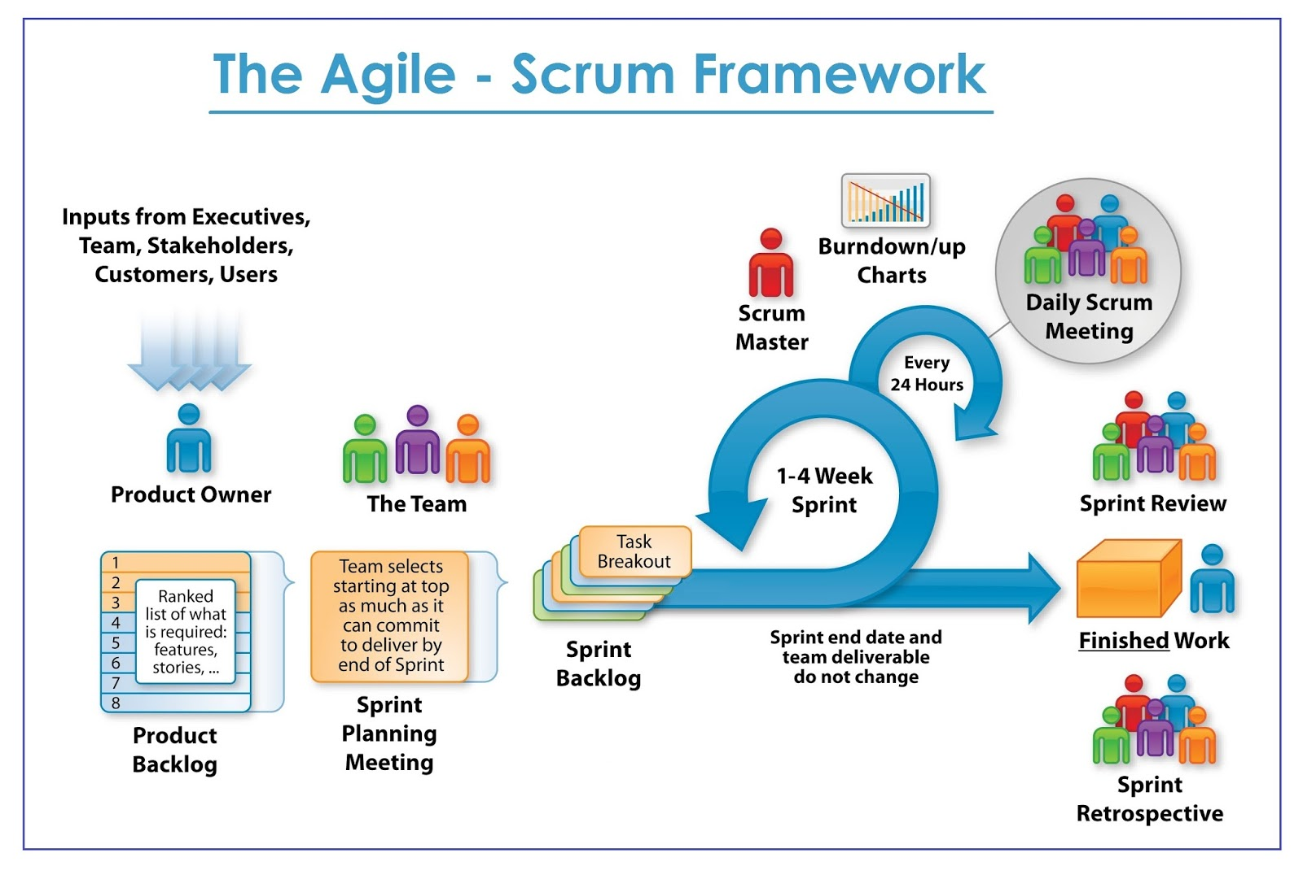

Slide 14
Scrum Framework
Roles
Product Owner
Scrum Master
Team
Ceremonies (In Scrum, Ceremonies = Official Meetings)
Sprint Planning
Sprint Review & Retrospective
Daily Scrum Meeting
Artifacts
Product Backlog
Sprint Backlog
Burndown charts

Slide 15
Scrum Roles
Product Owner
Possibly a Product Manager or Project Sponsor
Decides features, release date, prioritization, $$$
Conveys a clear vision to the Scrum team
Replies to frequently asked queries
Scrum Master
Typically a Project Manager or Team Leader
Responsible for enacting Scrum values and practices
Remove impediments / politics, keeps everyone productive
Project Team
5-10 members; Teams are self-organizing
Cross-functional: QA, Programmers, UI Designers, etc.
Membership should change only between sprints

Slide 16
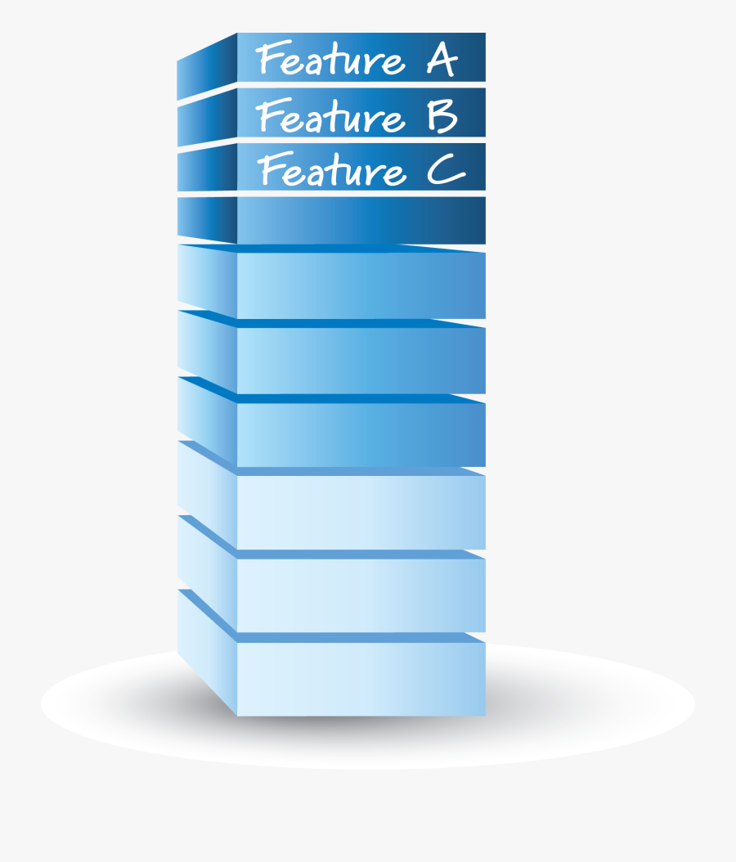
Artifact - Product Backlog
The requirements
A list of all desired work on project
Ideally expressed as a list of user stories along with "story points", such that each item has value to users or customers of the product
Prioritized by the product owner
Reprioritized at start of each sprint

Slide 17
Artifact - Product Backlog
Feature | Backlog item | Estimate
A | Allow a guest to make a reservation | 3 (story points)
B | As a guest, I want to cancel a reservation. | 5
C | As a guest, I want to change the dates of a reservation. | 3
D | As a hotel employee, I can run RevPAR reports (revenue-per-available-room) | 8
E | Improve exception handling | 8

Slide 18

Artifact - Sprint Backlog
High priority features are selected based on points from product backlog.
These features will be covered within that 1-4 weeks time slot called as sprint.
Estimated work remaining is updated daily
Any team member can not add, delete change sprint backlog

Slide 19
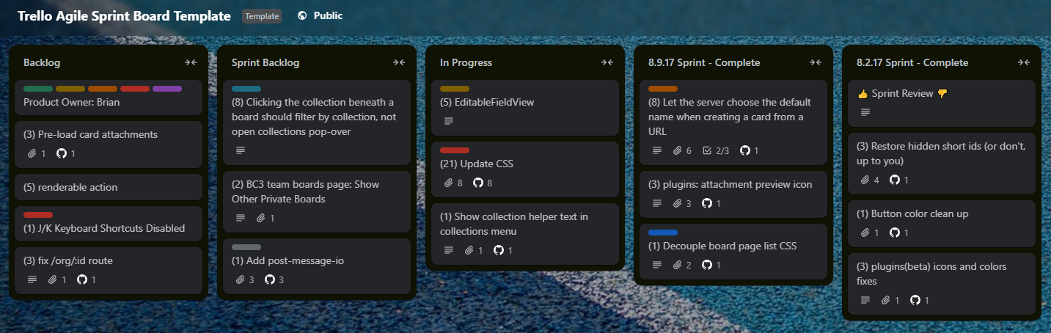
Artifact - Sprint Board
Template Link: https://trello.com/b/ZqN99gGN

Slide 20
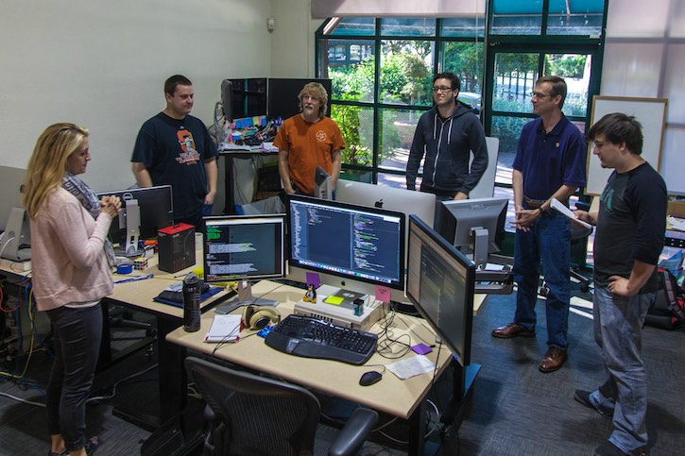
Ceremony - Daily Scrum Meeting (DSM)
Parameters
Daily, ~15 minutes, Stand-up
Anyone late pays a $1 fee
Not for problem solving
Whole world is invited
Only team members, Scrum Master, product owner, can talk
Helps avoid other unnecessary meetings
Three questions answered by each team member:
What did you do yesterday?
What will you do today?
What obstacles are in your way?

Slide 21
Artifact - Burndown Chart
A display of what work has been completed and what is left to complete (Remaining work vs time)
one for each developer or work item
updated every day
(make best guess about hours/points completed each day)
Release burndown chart
shows overall progress
updated at end of each sprint
2 min read: https://www.mountaingoatsoftware.com/agile/scrum/scrum-tools/release-burndown

Slide 22
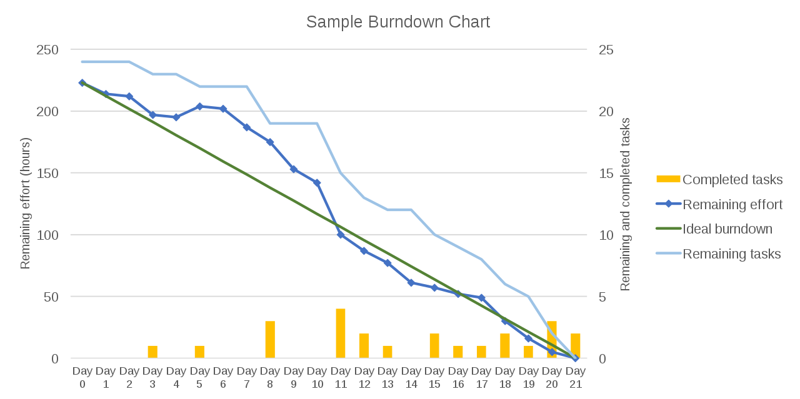
Artifact - Burndown Chart
If line goes down steadily → Good progress
If flat → Team not progressing
If goes up → New work added (not good in sprint)

Slide 23
Ceremony - Sprint Review
Team presents what it accomplished during the sprint
Demo of completed work
Informal
2-hour prep time rule
No slides
Whole team participates
Invite the world
“Show working product, not PowerPoint.”

Slide 24
Ceremony - Sprint Retrospective
Identify the scopes of improvement for better result in next sprints
What worked well, what went wrong are also discussed
2 min read: https://www.scrum.org/resources/what-is-a-sprint-retrospective

